Slide 1
Lab
03
Visualizing Attention

Slide 2
Lab Objectives
Learn how to log into Google Colab
Learn the basics of Colab
Run the demo to visualize Colab

Slide 3
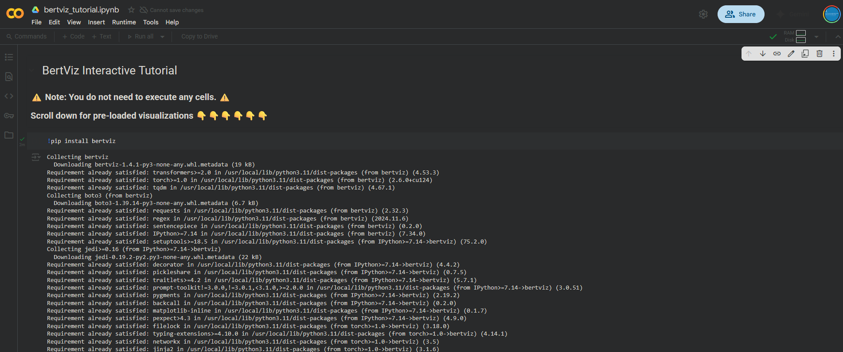
Navigate to the Demo Lab
Navigate to the demo lab:
https://colab.research.google.com/drive/1hXIQ77A4TYS4y3UthWF-Ci7V7vVUoxmQ?usp=sharing#scrollTo=aR07__FyOf8a

Slide 4
What is Google Colab?
Google Colab is simple a web representation of Jupyter Notebooks
“Jupyter Notebook is an open-source web application that allows you to create and share documents that contain live code, equations, visualizations, and narrative text. It is a popular tool among data scientists, researchers, and educators for interactive computing and data analysis. The name "Jupyter" is derived from the three core programming languages it originally supported: Julia, Python, and R.”
https://www.geeksforgeeks.org/data-science/jupyter-notebook/

Slide 5

What is Google Colab?
Google Colab-ratory is a free service that allows you to run Juypter notebooks in the google ecosystem
It is free
Depends on available resources
Typically a T4 instance in GCP
https://research.google.com/colaboratory/faq.html

Slide 6

What are Jupyter notebooks
A way to execute code via a web browser
But so much more
Notebook kernels are computational engines that execute blocks of code in a notebook document
Client-Server model
“Notebook documents (or “notebooks”, all lower case) are documents produced by the Jupyter Notebook App, which contain both computer code (e.g. python) and rich text elements (paragraph, equations, figures, links, etc…). Notebook documents are both human-readable documents containing the analysis description and the results (figures, tables, etc..) as well as executable documents which can be run to perform data analysis.”

Slide 7
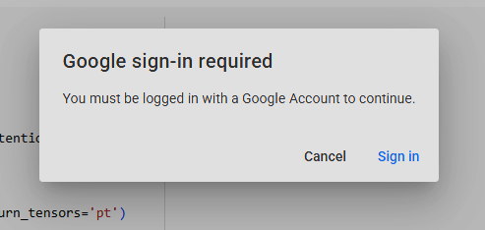
Getting started
Log into a google account to get started
If you need assistance with creating a real account or a “sock puppet” account please let us know

Slide 8
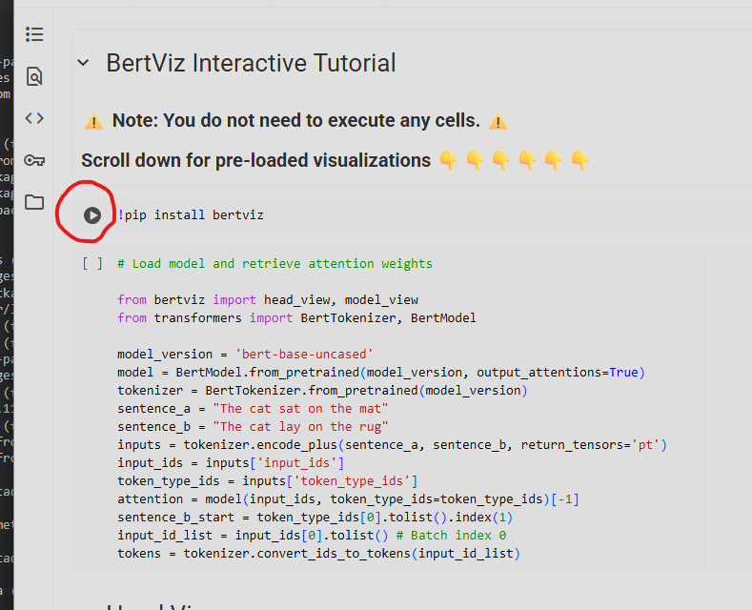
Running through the demo lab
Once you are signed in you will run through the playbook “chunk” by “chunk” by clicking the play buttons next to each chunk

Slide 9
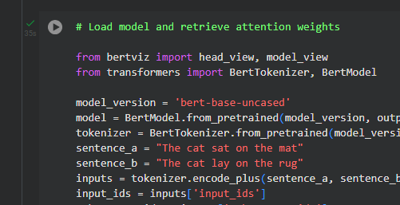
Running through the demo lab
As you finish each section, you will see a little green checkmark next to a successful run

Slide 10
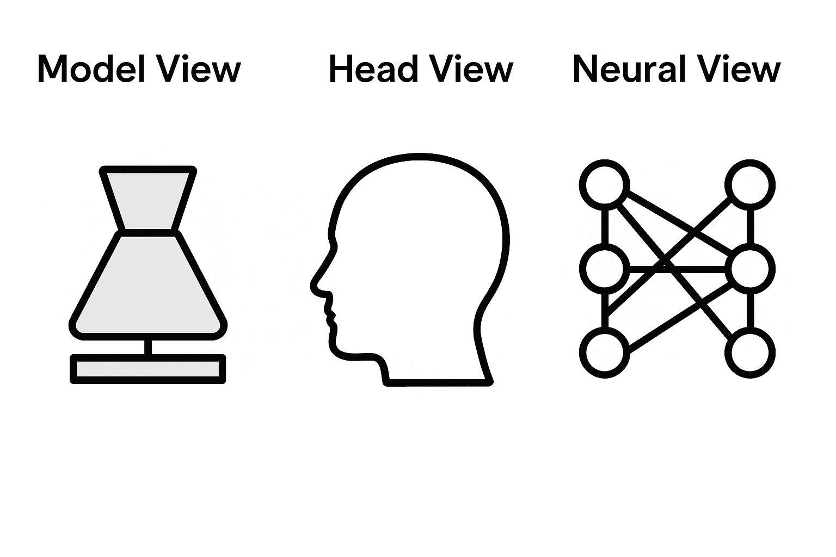
Model Views
Once completed you will see several views demonstrated in the following slides

Slide 11
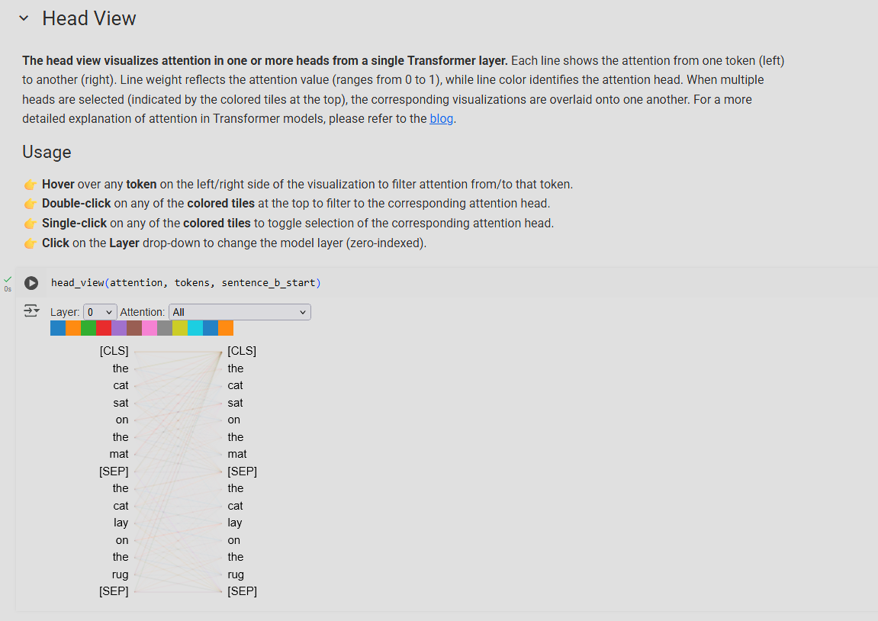
Visualizing Attention
Head View:

Slide 12
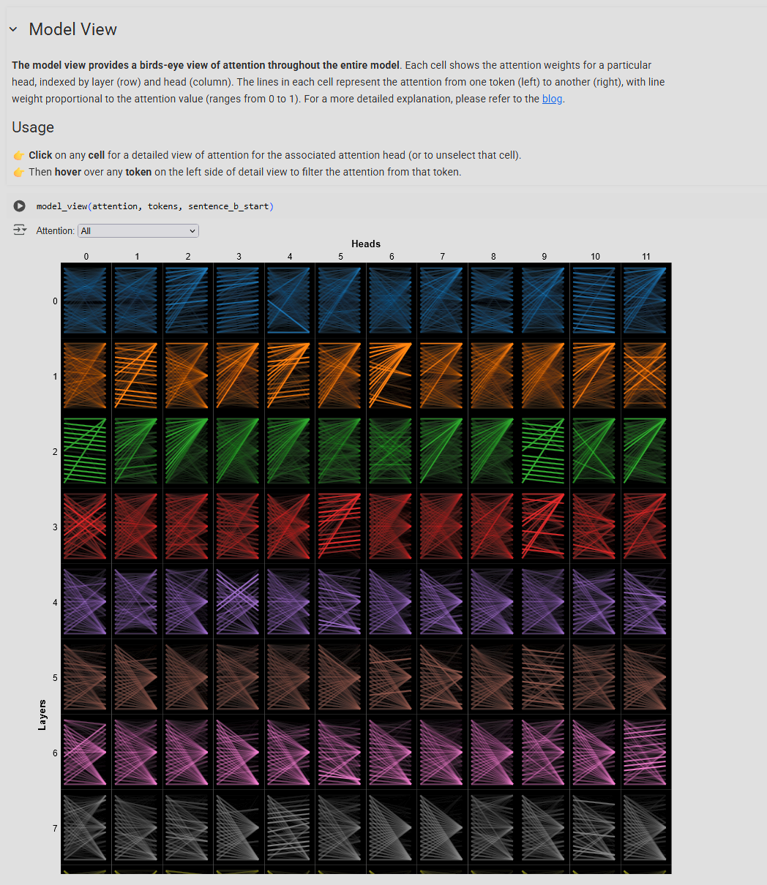
Visualizing Attention
Model View:

Slide 13
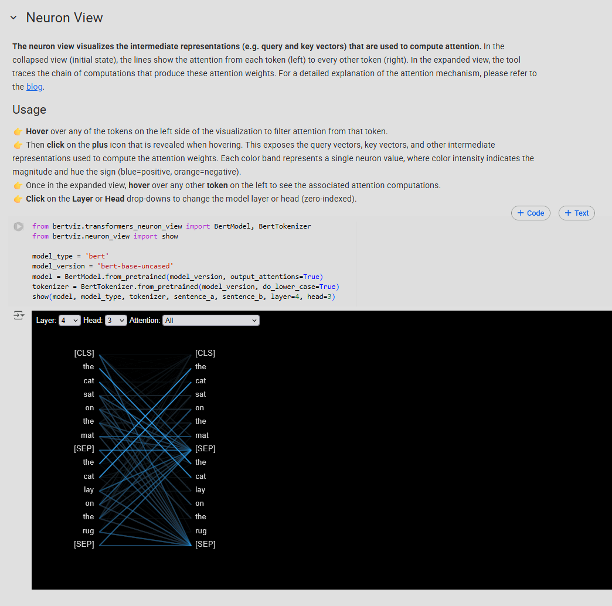
Visualizing Attention
Neural View

Slide 14
Visualizing Attention
Github repository: https://github.com/jessevig/bertviz?tab=readme-ov-file

Slide 15
Lab End

